Slide 1

EARNINGS ENIGMA: CRACKING THE CODE WITH K-NN AND NAÏVE BAYES
Aloysius Peter and Varun Vedula
KENT STATE UNIVERSITY
CAPSTONE PROJECT IN BUSINESS ANALYTICS (BA-64099-024)
Notes:
Peter: Welcome to our presentation on "Earnings Enigma: Cracking the Code with K-NN and Naïve Bayes." I’m Aloysius Peter.
Varun: And I’m Varun Vedula. We're excited to take you through our capstone project, completed at Kent State University as part of our Business Analytics program. We'll demonstrate how our models can be applied in real-world business scenarios.

Slide 2
P R O J E C T S T R U C T U R E
Data
Feature Selection
Algorithm
Ethical Concerns
Findings
Notes:
Varun: Our project's goal is to develop a machine learning model that accurately predicts if an individual earns more or less than $50,000 annually, using socio-economic and demographic factors.
Peter: These insights are crucial for businesses such as financial institutions for loan approvals, marketing companies for targeted campaigns, and policymakers for economic planning. Accurate income predictions can significantly enhance decision-making processes.
Peter: Our approach involves understanding the data, identifying influencing factors, building predictive models using KNN and Naïve Bayes, and evaluating their performance. We aim to create a robust model that provides accurate predictions.
Varun: Additionally, we address any ethical concerns to ensure fair and responsible use of our prediction model. This is crucial for businesses to maintain public trust and comply with regulations.

Slide 3





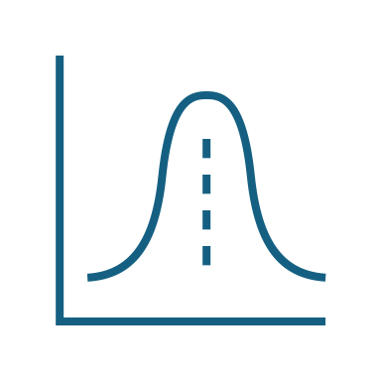
D A T A
Data Exploration and Cleaning
Data Cleaning Descriptive Statistics
Data Transformation
One Hot Encoding Normalization
Notes:
Varun: The dataset, sourced from Kaggle, includes 15 variables: 14 supporting variables and 1 output variable, with 32,561 rows. This diverse dataset helps in creating a comprehensive model.
Peter: It contains 6 quantitative, 1 binary, and 7 qualitative variables. The output variable is 'Income,' a binary classification indicating whether an individual earns more or less than $50,000 annually. This dataset can help businesses tailor their services based on income predictions.
Peter: We addressed missing values, which accounted for 0.87% of the total data. These lines were deleted, and missing data were replaced with 'NA' for better handling in R. Ensuring data quality is essential for accurate model training.
Varun: We also corrected the format of numerical variables that were mistakenly formatted as characters. This step was crucial to ensure that our data was correctly interpreted by the model.
Slide 6: Descriptive Statistics
Varun: Descriptive statistics summarize the dataset's characteristics, helping us understand it better. We used summary statistics, scatter plots, bar plots, and box plots to visualize and analyze the data.
Peter: These visualizations revealed insights such as the working-class population's income distribution and the impact of education on income. For instance, a marketing company can use these insights to tailor advertisements based on education levels.
Peter: We used One-Hot Encoding to convert categorical variables into dummy variables, allowing the model to understand their numerical importance. This step was vital for accurate model training.
Varun: We also applied normalization to ensure all variable scales are uniform, making it easier for the model to evaluate each variable's significance. This process helps in improving the model's performance, especially in financial risk assessments.

Slide 4



F E A T U R E S E L E C T I O N
Age, Hours per week, Work Class and Education
Correlation Plot &
Pair Plot Matrix
Backward Stepwise
Regression
PCA
(Principal Component Analysis)
Notes:
Varun: We used correlation plots and pair plots to identify relationships between variables, helping us focus on strong predictors of income. This analysis was key to selecting relevant features.
Peter: Additionally, we employed backward stepwise regression and Principal Component Analysis (PCA) to simplify our model while maintaining predictive power. For example, a bank can use these techniques to determine the most critical factors influencing loan defaults.

Slide 5
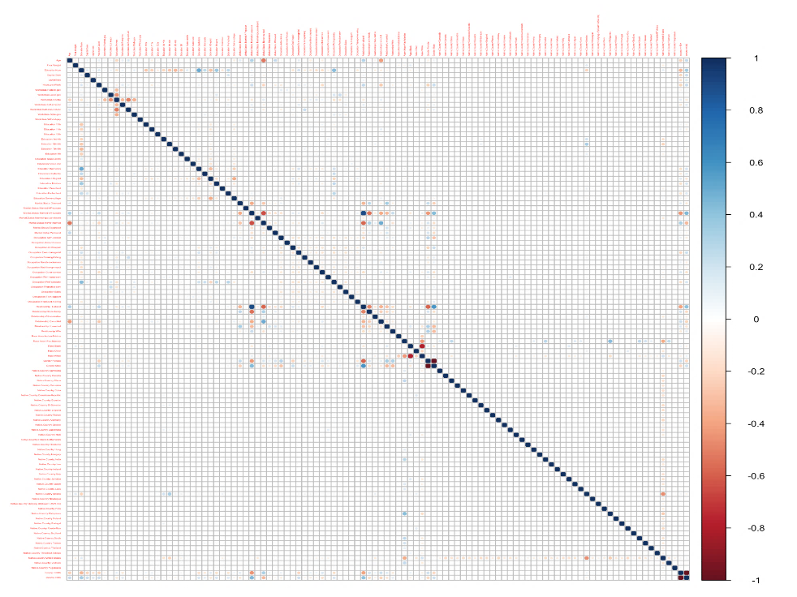
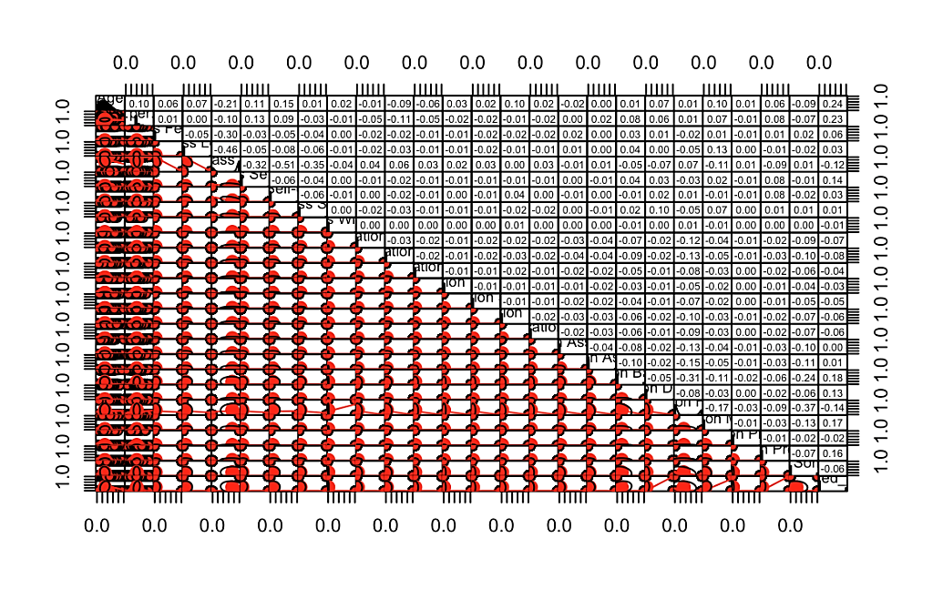
C O R R E L A T I O N & P A I R M A T R I X P L O T
Correlation Plot
Pair Matrix Plot
* Pair plot only for selected variables
Notes:
Varun : Correlation Plot - It is a graphical representation that shows the relation between multiple variables amongst them. It is a matrix format where the correlation indicates the strength and how correlated they are within them. This representation shows which variables are heavily correlated. According to the correlation plot we have selected the variables Age, and Hours. Per. Week, Work class, and Education.
Peter : Pair Matrix Plot - This plot visualizes the pairwise relationship between the variables, it graphically and numerically offers a comprehensive view of correlation, distribution, and weightage of each variable amongst the variables, where the correlation plot just shows the visual correlation coefficient of the variables amongst itself.

Slide 6
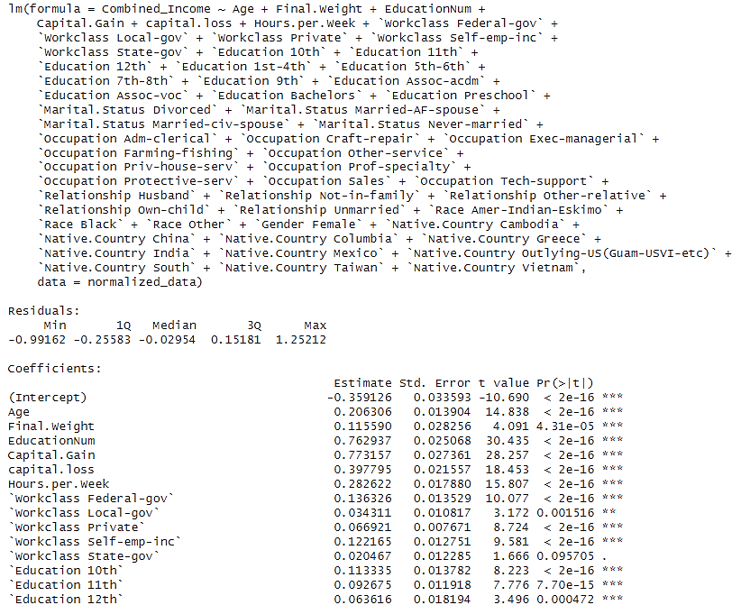
B A C K W A R D S T E P W I S E R E G R E S S I O N
Backward stepwise regression is a method where you start with all possible variables in a model and remove the least important ones one by one until only the significant variables remain. This helps simplify the model while keeping its predictive power.
*Image not of full value because of space constraint
Notes:
Peter : read the para above

Slide 7
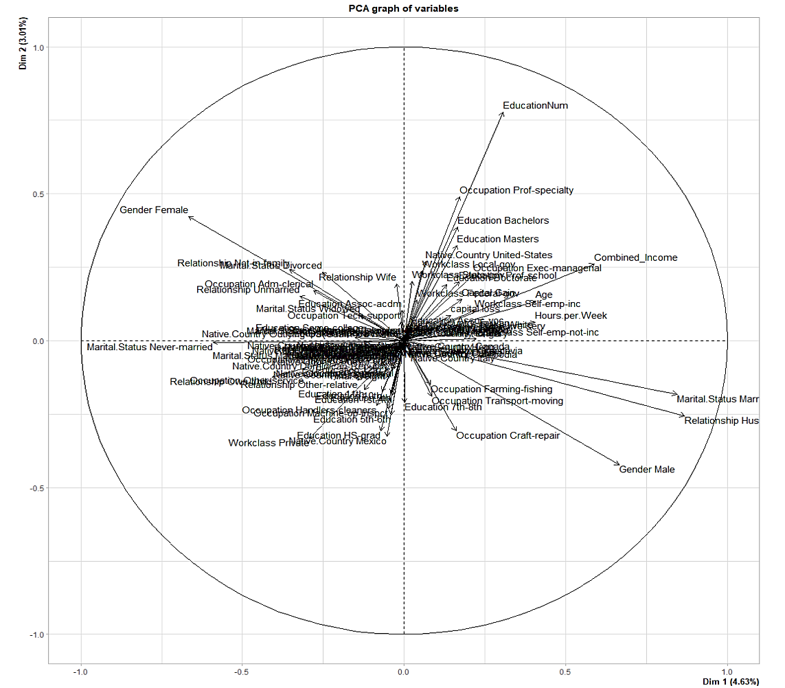
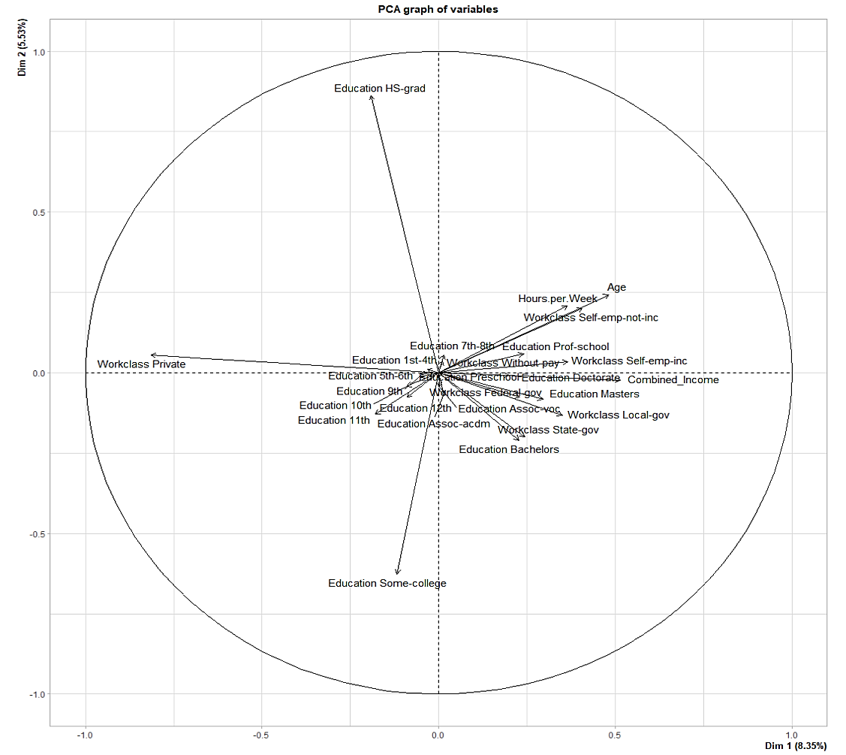
P C A (P R I N C I P A L C O M P O N E N T A N A L Y S I S)
For All Variables
For Selected Variables
Notes:
Varun: According to the PCA, the variables are scattered and some overlap. Choosing variables that are aligned in the same direction or that overlap won't contribute much. Instead, we should select the variables that are farthest apart and not overlapping. The left chart on the slide is the PCA for all variables and the right chart is the PCA only for Selected Variables. The correct PCA plot for the chosen variables clearly shows the differences among them.

Slide 8


A L G O R I T H M
KNN
NAÏVE BAYES
Notes:
The Algorithms best suited for this project are Knn and naïve bayes bcoz they are classification and predictive models.

Slide 9


K N N C L A S S I F I C A T I O N
K = 5
K = 7
K = 9
Accuracy | 78.38%
Recall | 42.42%
Precision | 60.02%
Specificity | 90.44%
F1 Score | 49.00%
Accuracy | 79.09%
Recall | 42.10%
Precision | 62.80%
Specificity | 91.59%
F1 Score | 50.03%
Accuracy | 79.17%
Recall | 41.50%
Precision | 63.40%
Specificity | 91.59%
F1 Score | 50.10%
Scoring metrics from confusion matrix
Notes:
Peter: KNN, or K-Nearest Neighbors, was one of the algorithms we used. We tested it with different values of K: 5, 7, and 9, to find the optimal parameter. This process involved hyperparameter tuning to improve accuracy.
Varun: Our results showed varying accuracy, recall, precision, specificity, and F1 scores, with K=9 providing the best overall performance. This highlighted the importance of selecting the right K value for applications like customer segmentation in retail.

Slide 10


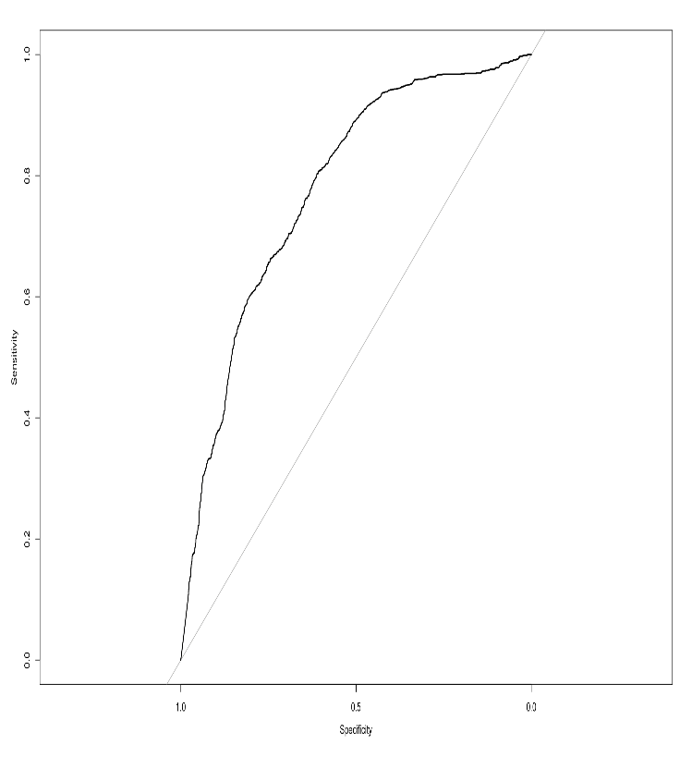
N A Ï V E B A Y E S
Confusion Matrix
ROC Curve
Accuracy | 34.53%
Recall | 96.90%
Precision | 26.80%
Specificity | 26.80%
F1 Score | 41.96%
Notes:
Varun: We also used the Naïve Bayes algorithm. It performed well on recall but had lower accuracy and precision compared to KNN. This algorithm helped us understand the trade-offs between different evaluation metrics.
Peter: The evaluation included confusion matrices and ROC curves, which helped us understand the strengths and weaknesses of the model. For example, a healthcare provider could use this model to identify high-risk patients based on income and other factors.

Slide 11
F I N D I N G S
KNN
NAÏVE BAYES
True Negatives (TN) | 4145
False Positives (FP) | 365
False Negatives (FN) | 891
True Positives (TP) | 631
Total Observations | 6032
True Negatives (TN) | 654
False Positives (FP) | 3903
False Negatives (FN) | 45
True Positives (TP) | 1430
Total Observations | 6032
Accuracy | 79.17%
Recall | 41.50%
Precision | 63.40%
Specificity | 91.59%
F1 Score | 50.10%
Accuracy | 34.53%
Recall | 96.90%
Precision | 26.80%
Specificity | 26.80%
F1 Score | 41.96%
Notes:
Peter: For KNN, the best accuracy achieved was 79.17%, with a recall of 41.50%, precision of 63.40%, specificity of 91.59%, and an F1 score of 50.10%. These results demonstrated the effectiveness of the KNN algorithm for applications like personalized marketing.
Varun: For Naïve Bayes, the accuracy was 34.53%, with a high recall of 96.90%, precision of 26.80%, specificity of 26.80%, and an F1 score of 41.96%. This showed that while Naïve Bayes excelled in recall, it had trade-offs in other metrics, making it suitable for use cases like fraud detection where recall is critical.

Slide 12






E T H I C A L C O N C E R N S
Fairness and Bias
Transparency
Informed Consent
Accountability
Data Privacy
Benefit vs Harm
Our model’s only ethical dilemma arises from data, the data was sourced from Kaggle, and they have free usage rights on the data, with consent from the individuals because of which our model is not impacted with ethical concerns.
Notes:
Varun: We considered fairness, bias, transparency, data privacy, informed consent, accountability, and the balance between benefit and harm. Addressing these ethical concerns was essential for our project.
Peter: Our model’s ethical concerns were minimal as the data was sourced from Kaggle with free usage rights and proper consent from individuals. Ensuring ethical use of data is critical for maintaining public trust and complying with regulations, especially in sensitive areas like financial services.
Conclusion:Peter: In conclusion, while KNN showed better overall accuracy, Naïve Bayes excelled in recall. Both models provide valuable insights for predicting income levels, highlighting the strengths of different machine learning algorithms. We will be recommending KNN for this model as this models metrics is more suited for the data we have selected and the model we are trying to achieve.
Varun: We hope our project demonstrates the practical applications of machine learning in business analytics and its potential for cost-effective data-driven decision-making. Our approach shows how machine learning can be used effectively even with budget constraints, benefiting various industries like finance, marketing, and healthcare.

